Slide 1
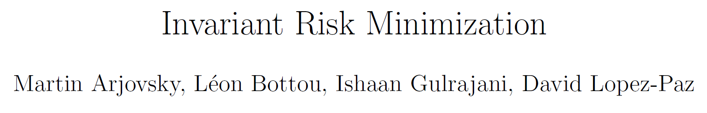
Presented by Mingle Xu
2023 Oct 20
Jeonbuk National University

Slide 2
Content
Motivation: understanding the features and learning better features to achieve better generalization
Two types of generalization
What is the good representation, the characteristics.
Types of features and related understanding
Causal features
Correlation features, including spurious correlation
Intimate link between invariance and causation
Many faces of generalization and one example
IRM algorithm and the conceptualization, and related feasible loss function.
IRM Experiments
Challenges and questions
Environments
With deep learning
Confliction towards the assumption about the marginal shift

Slide 3
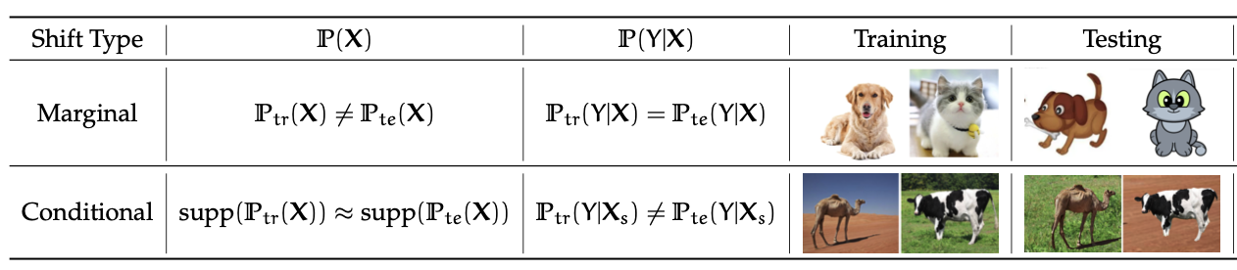
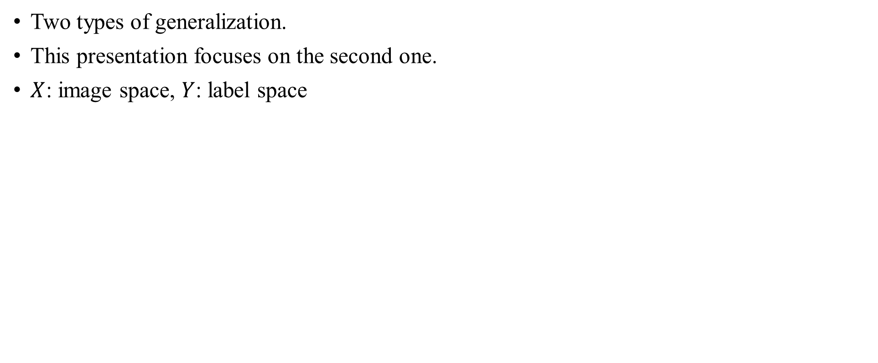
Motivation: achieve better generalization
Two types of generalization.
This presentation focuses on the second one.
$X$: image space, $Y$: label space
Conditional distribution is changing, such as the correlation between label and background.
Picture from https://zhuanlan.zhihu.com/p/567666715

Slide 4
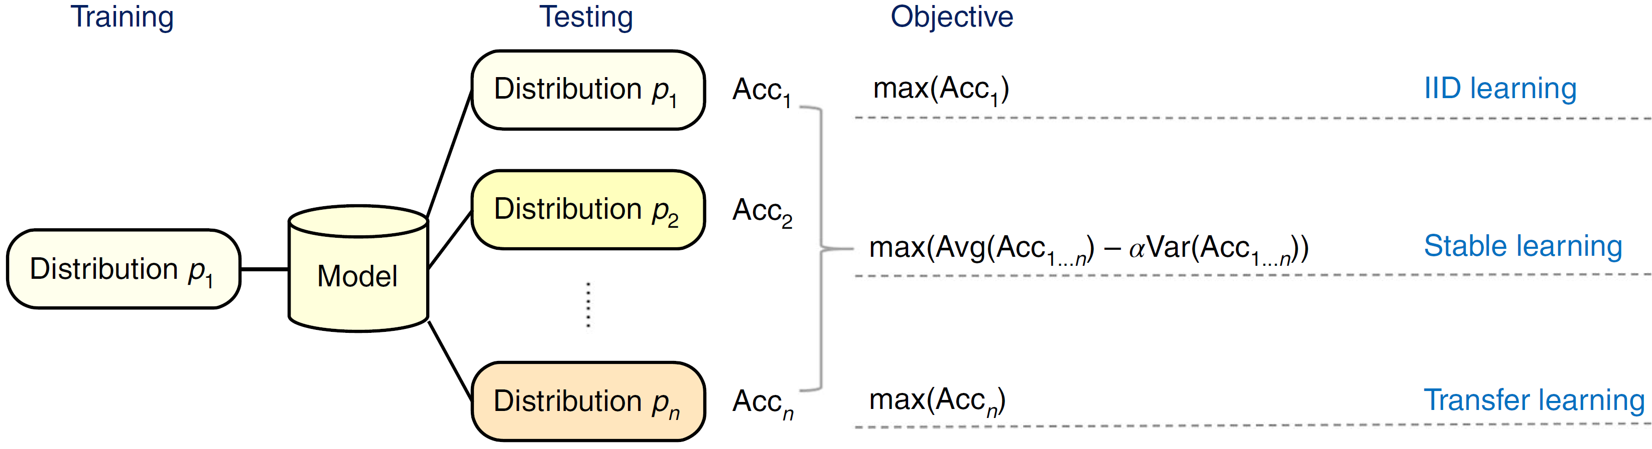
The position of generalization and related paradigm
Generalization and stable learning.
"Stable learning establishes some common ground between causal inference and machine learning." Nature Machine Intelligence (2022)

Slide 5
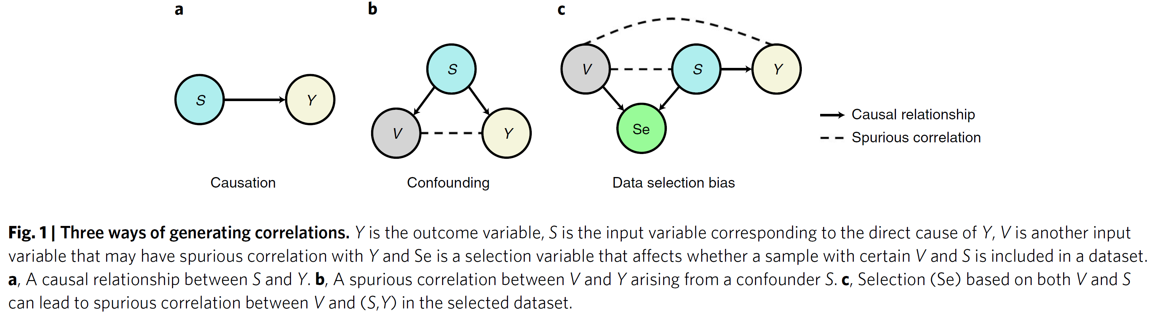
Dataset and learned presentation are the main factors.
S: condition of a patient
V: common cause of ICU
Y: recovery rate
S: feature of dogs
V: feature of grasses
Y: dog label
Se: selection of samples with dogs on grasses.
Weather → crop yield
"Stable learning establishes some common ground between causal inference and machine learning." Nature Machine Intelligence (2022)

Slide 6
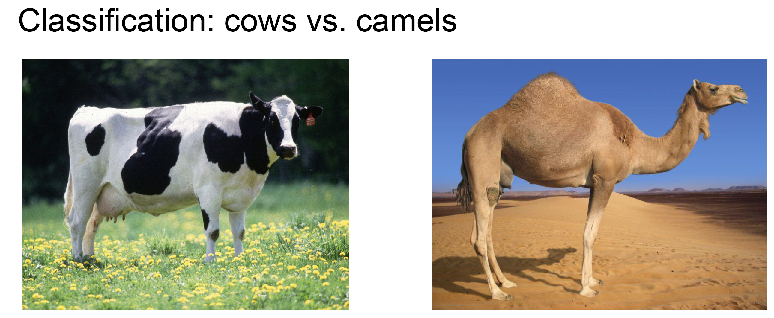
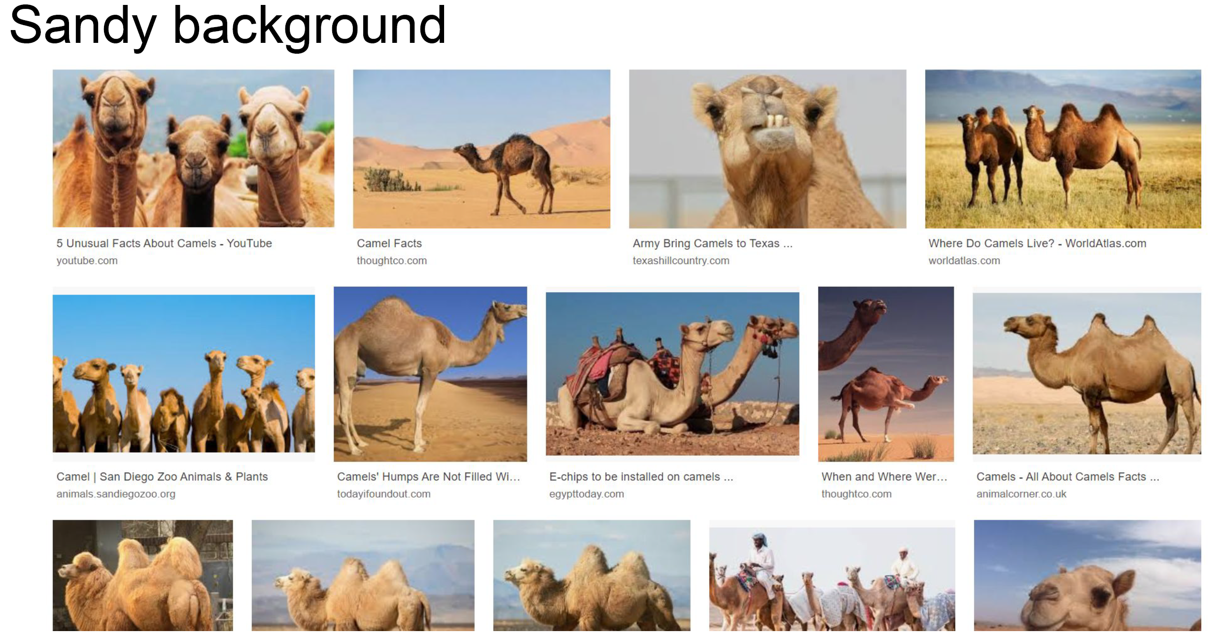
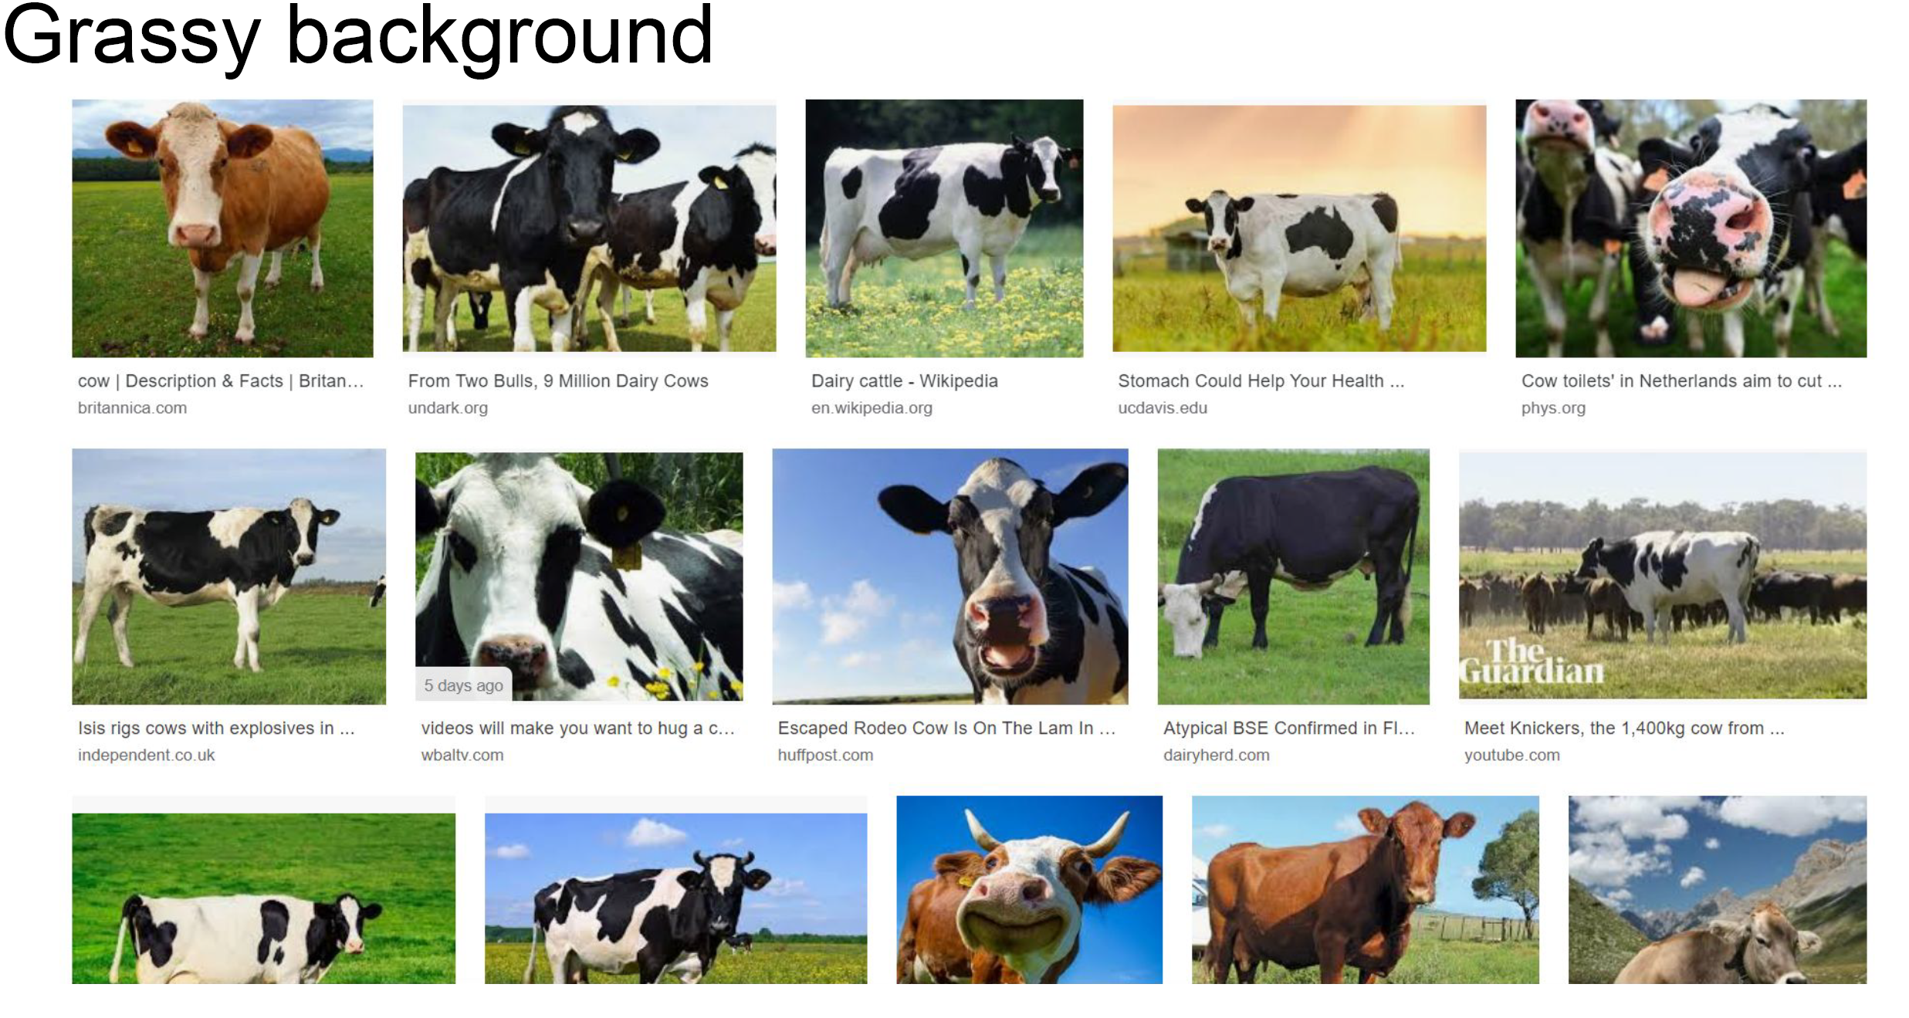
Is the last picture a camel or cow?

Slide 7
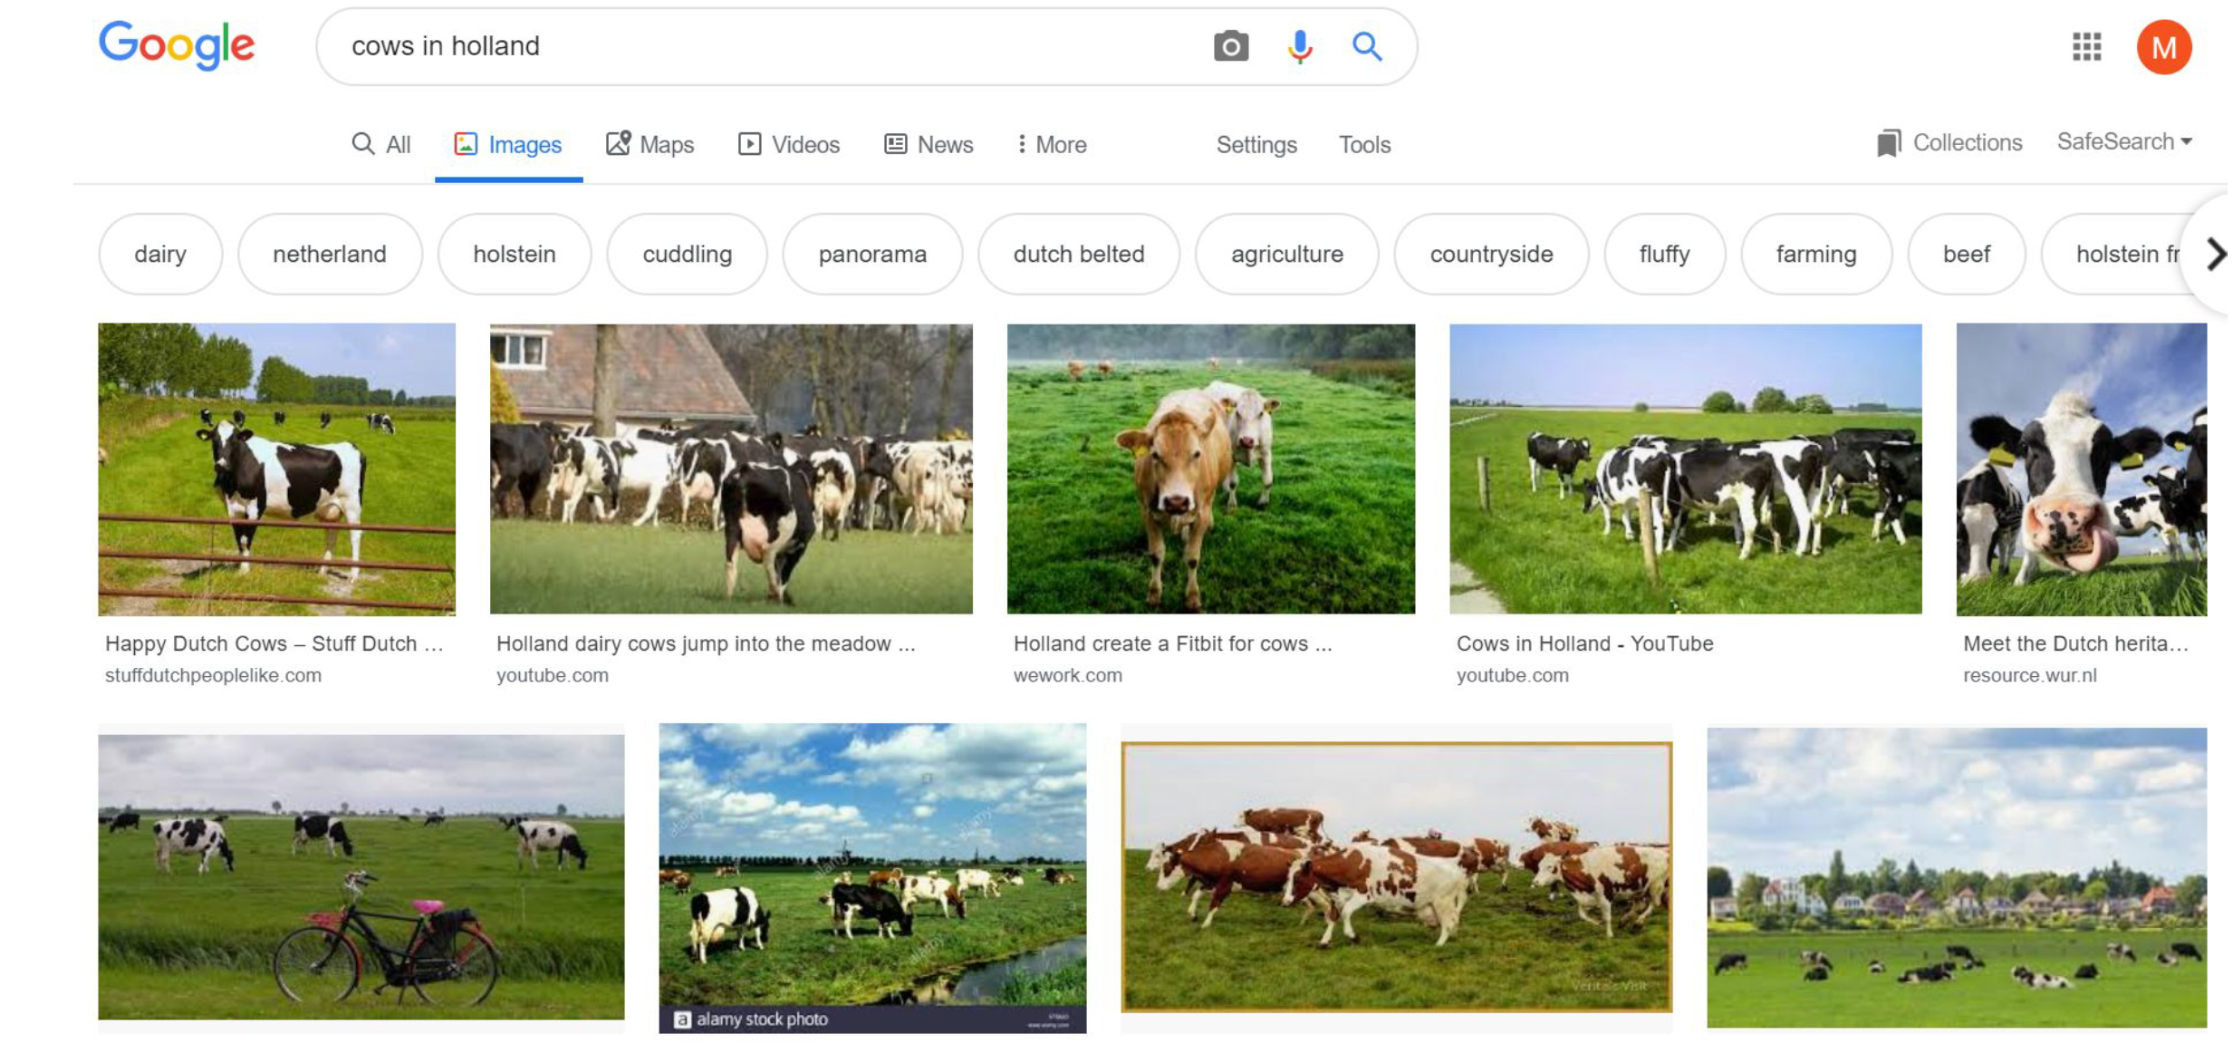
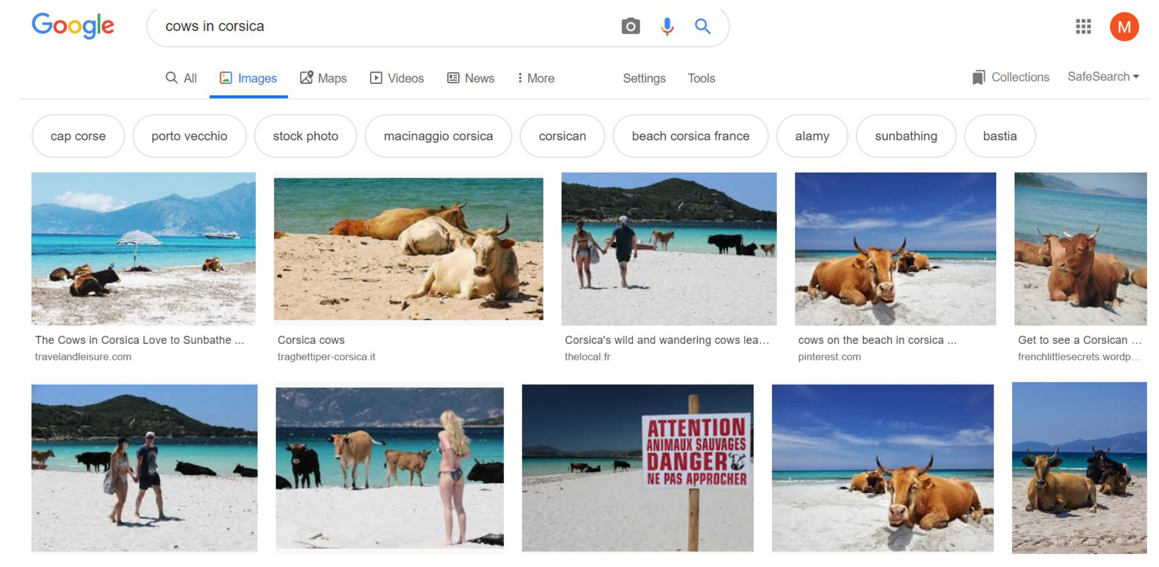
Spurious correlation and environments
Background is a kind of spurious feature.
We will call the background and other spurious correlation as environment.

Slide 8
Correlation-versus-causation dilemma
Minimizing training error leads machines into recklessly absorbing all the correlations found in training data.
However, spurious correlations stemming from data biases are unrelated to the causal explanation of interest.
Problem: identify which properties of the training data describe spurious correlations (landscapes and contexts), and which properties represent the phenomenon of interest (animal shapes).
Deep learning tends to learn correlations, rather than causal one.
Learning casual feature is complicated.
"Stable learning establishes some common ground between causal inference and machine learning." Nature Machine Intelligence (2022)

Slide 9
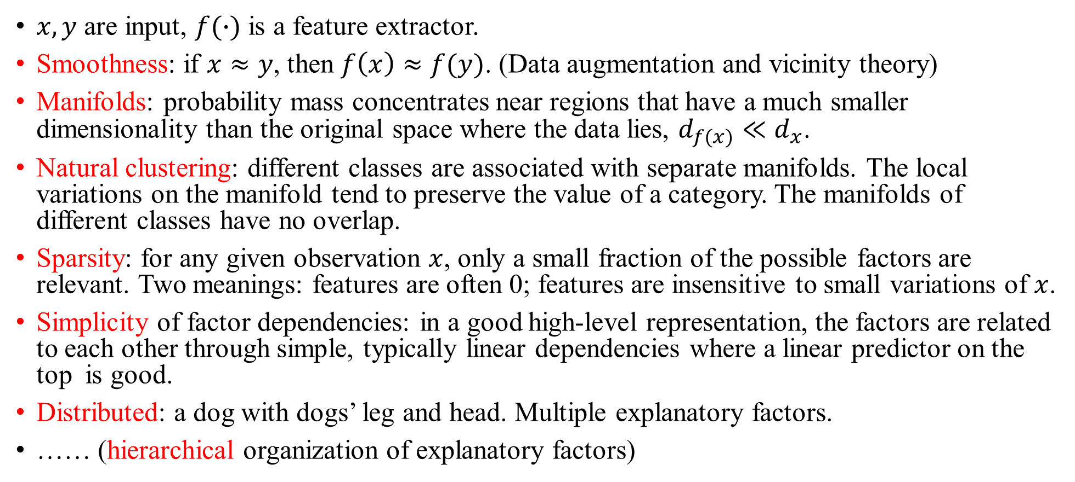
What is the characteristics of good features or representations?
$x,y$ are input, $f(∙)$ is a feature extractor.
Smoothness: if $x≈y$, then $f\left(x\right)≈f(y)$. (Data augmentation and vicinity theory)
Manifolds: probability mass concentrates near regions that have a much smaller dimensionality than the original space where the data lies, $d_{f(x)}≪d_{x}$.
Natural clustering: different classes are associated with separate manifolds. The local variations on the manifold tend to preserve the value of a category. The manifolds of different classes have no overlap.
Sparsity: for any given observation $x$, only a small fraction of the possible factors are relevant. Two meanings: features are often 0; features are insensitive to small variations of $x$.
Simplicity of factor dependencies: in a good high-level representation, the factors are related to each other through simple, typically linear dependencies where a linear predictor on the top is good.
Distributed: a dog with dogs’ leg and head. Multiple explanatory factors.
…… (hierarchical organization of explanatory factors)
Bengio, Yoshua, Aaron Courville, and Pascal Vincent. "Representation learning: A review and new perspectives.“ PAMI 2013

Slide 10
Causation → invariance
Spurious correlations do not appear to be stable properties.
Yet, there exists an intimate link between invariance and causation useful for generalization.
(That’s why shuffling is actually not that OK: we destroy information about how the data distribution changes ⇒ no way to know which properties are stable.)

Slide 11
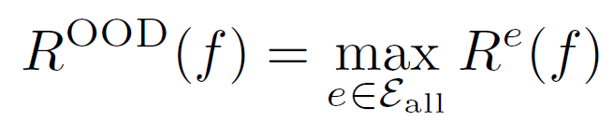
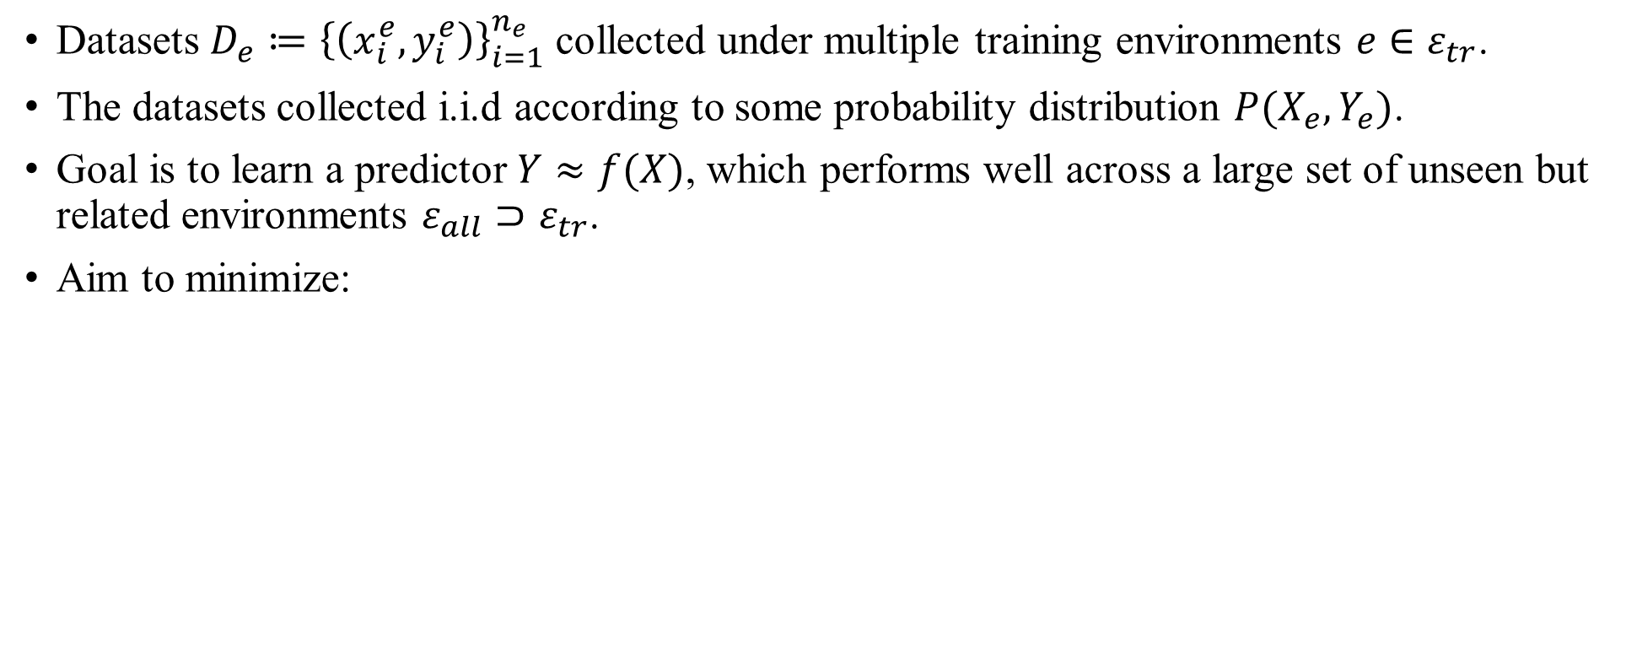
Formalization of OOD generalization
Datasets $D_{e}≔{\left\{\left(x_{i}^{e},y_{i}^{e}\right)\right\}}_{i=1}^{n_{e}}$ collected under multiple training environments $e∈ε_{tr}$.
The datasets collected i.i.d according to some probability distribution $P(X_{e},Y_{e})$.
Goal is to learn a predictor $Y≈f(X)$, which performs well across a large set of unseen but related environments $ε_{all}⊃ε_{tr}$.
Aim to minimize:

Slide 12
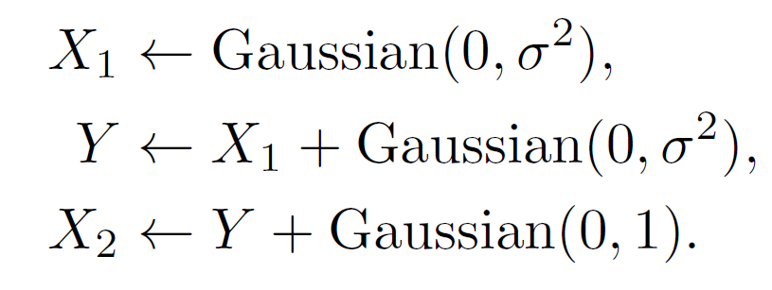
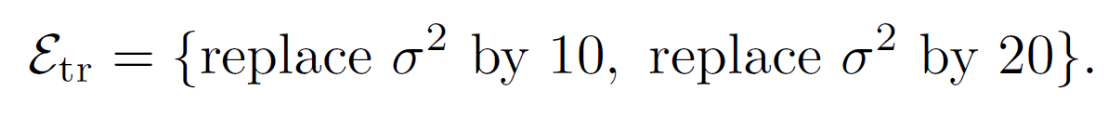
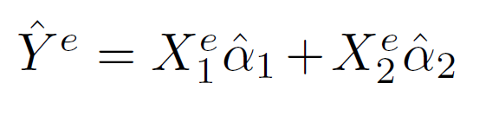
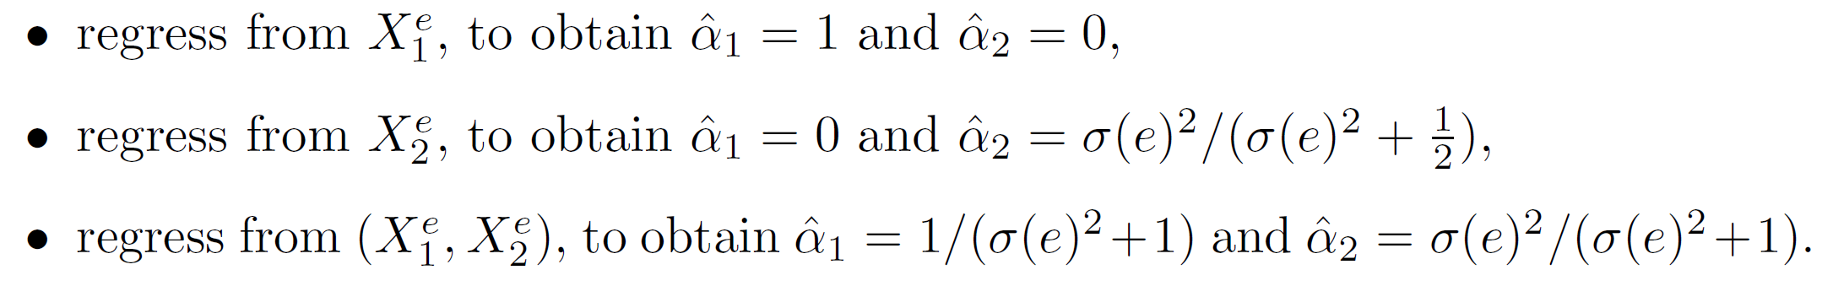
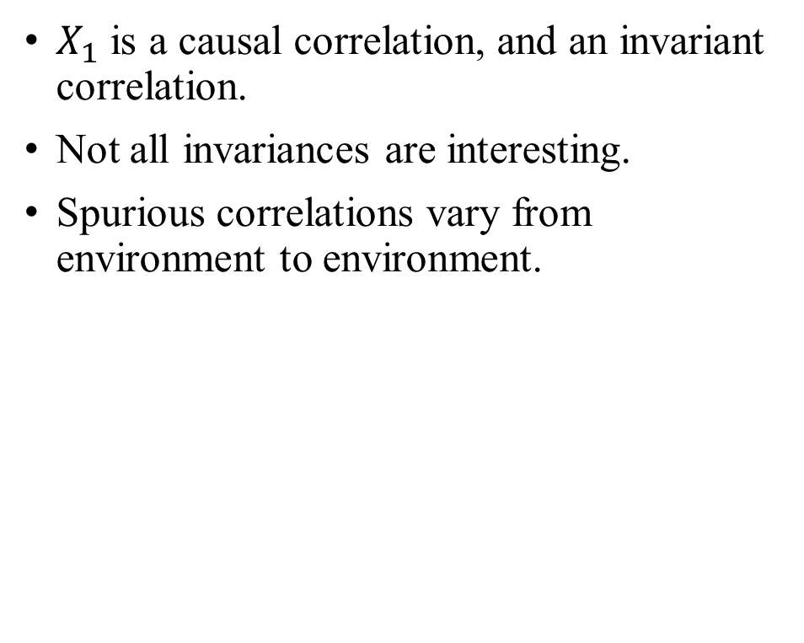
A simple example of OOD generalization
$X_{1}$ is a causal correlation, and an invariant correlation.
Not all invariances are interesting.
Spurious correlations vary from environment to environment.

Slide 13
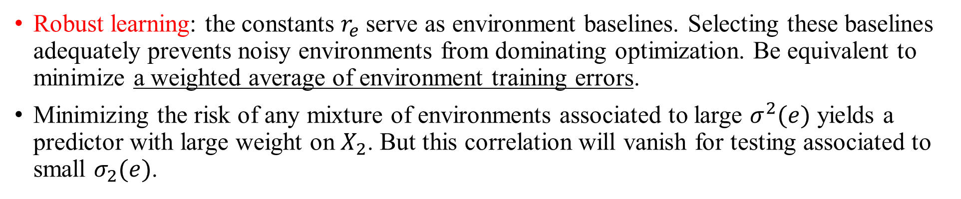
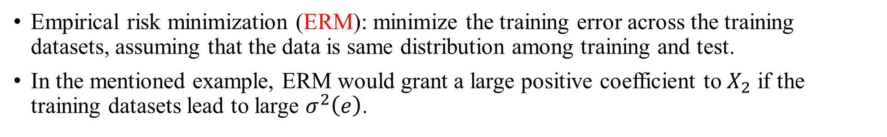
Other methods for OOD generalization
Empirical risk minimization (ERM): minimize the training error across the training datasets, assuming that the data is same distribution among training and test.
In the mentioned example, ERM would grant a large positive coefficient to $X_{2}$ if the training datasets lead to large $σ^{2}\left(e\right)$.
Robust learning: the constants $r_{e}$ serve as environment baselines. Selecting these baselines adequately prevents noisy environments from dominating optimization. Be equivalent to minimize a weighted average of environment training errors.
Minimizing the risk of any mixture of environments associated to large $σ^{2}(e)$ yields a predictor with large weight on $X_{2}$. But this correlation will vanish for testing associated to small $σ_{2}(e)$.

Slide 14
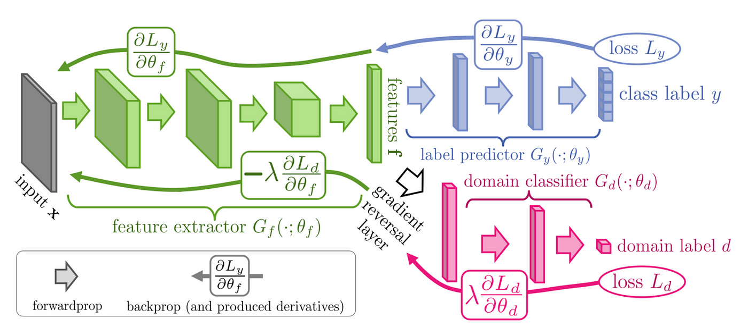
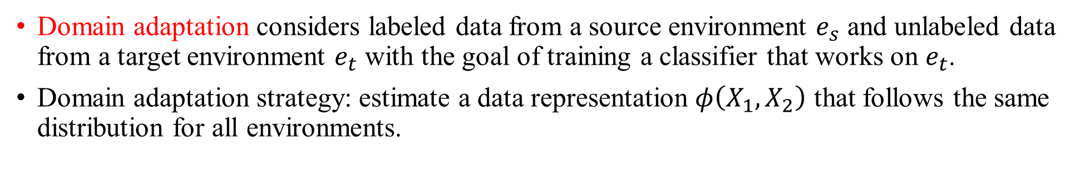
Other methods for OOD generalization
Domain adaptation considers labeled data from a source environment $e_{s}$ and unlabeled data from a target environment $e_{t}$ with the goal of training a classifier that works on $e_{t}$.
Domain adaptation strategy: estimate a data representation $φ\left(X_{1},X_{2}\right)$ that follows the same distribution for all environments.
But the distribution of the true causal feature can change across environments, which means that the features from different environments sometimes are different.
"Domain-adversarial training of neural networks." The journal of machine learning research, 2016

Slide 15
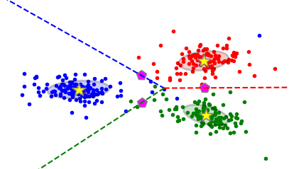
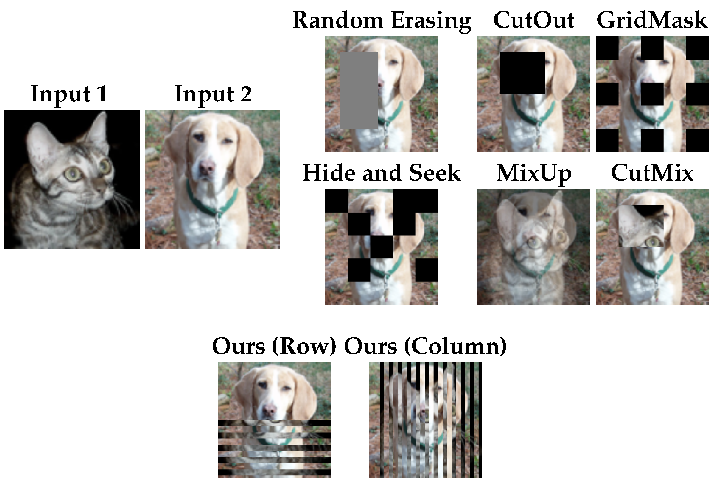
High level idea about learning invariances.
To learn invariances across environments, find a data representation such that the optimal classifier on top of that representation matches for all environments.
Mark from Mingle:
Two things: representation and classifier.
Distribution of feature space for one class, not a point, reminding of sparsity, multiple explanatory factors. Not aim to learn invariant representations for classes since representation should not be same for one class.

Slide 16
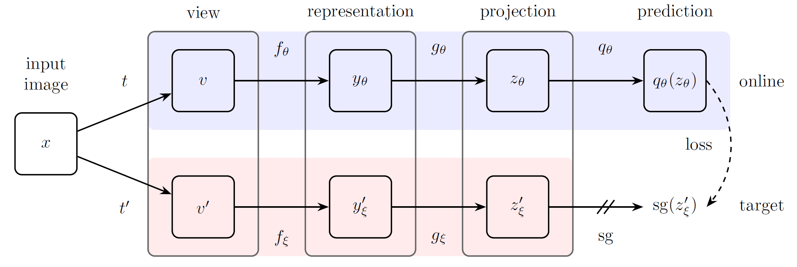
A little bit more about the invariance
The meaning of the prediction head in self-supervised learning (SSL).
An offset to reduce the variation because of image augmentation.
Bootstrap your own latent-a new approach to self-supervised learning. NIPS 2020

Slide 17
Thinking from this assumption
To detect unknown (OSR), feature space may not be the best level, logits could be the optimal.

Slide 18
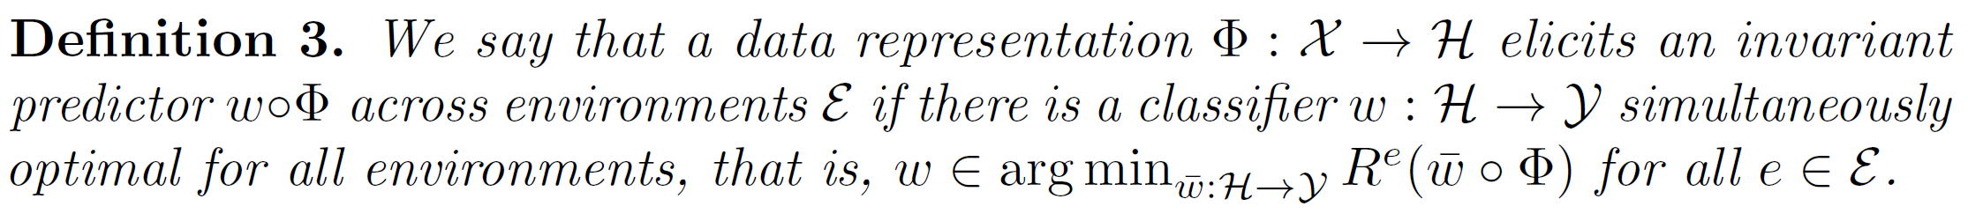
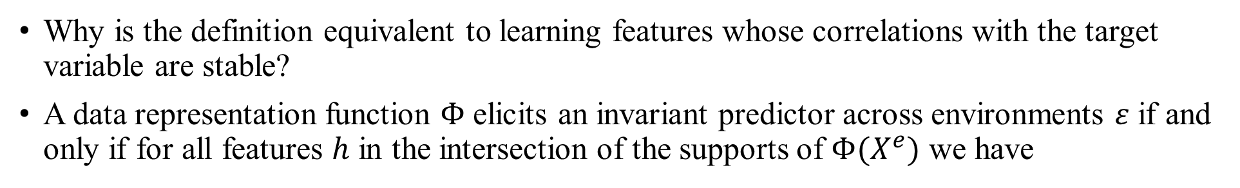
Objective of IRM (invariant risk minimization)
Why is the definition equivalent to learning features whose correlations with the target variable are stable?
A data representation function $Φ$ elicits an invariant predictor across environments $ε$ if and only if for all features $h$ in the intersection of the supports of $Φ(X^{e})$ we have
The concept of invariance classifies common induction methods, not deduction.

Slide 19
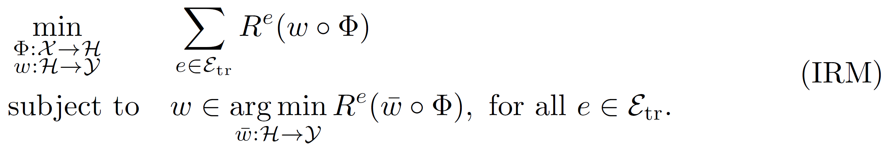
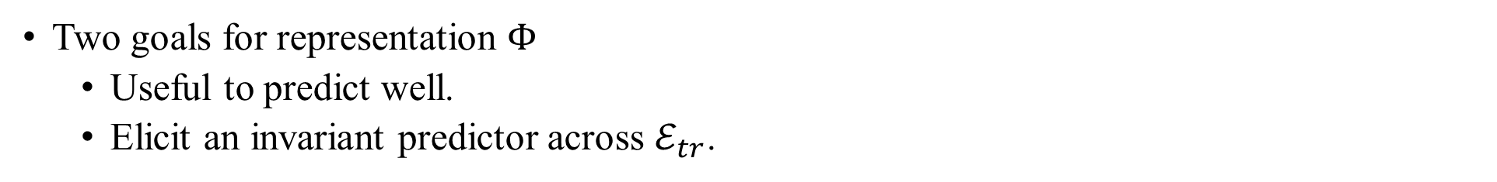
Finally, IRM
Two goals for representation $Φ$
Useful to predict well.
Elicit an invariant predictor across $ℰ_{tr}$.
However, this is a bi-leveled optimization problem.

Slide 20
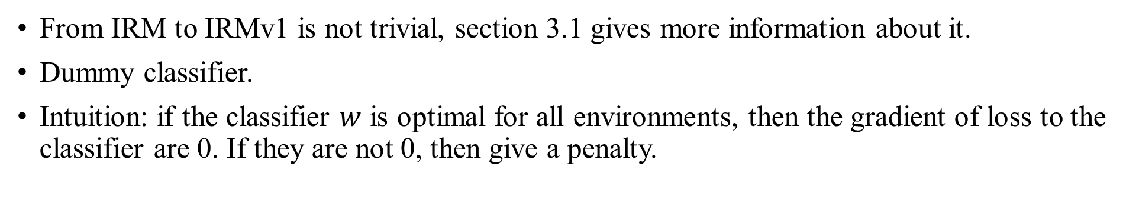
A practical version of IRM
From IRM to IRMv1 is not trivial, section 3.1 gives more information about it.
Dummy classifier.
Intuition: if the classifier $w$ is optimal for all environments, then the gradient of loss to the classifier are 0. If they are not 0, then give a penalty.

Slide 21
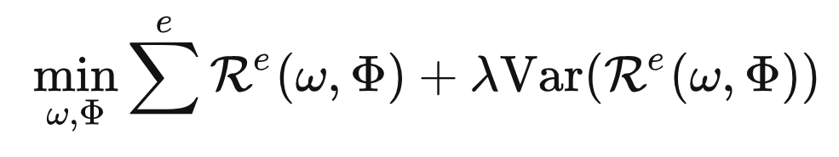
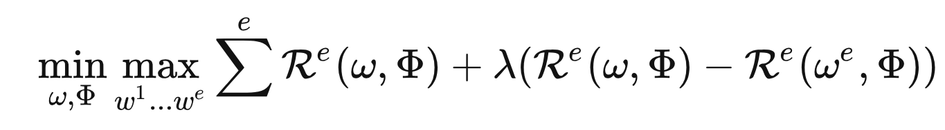
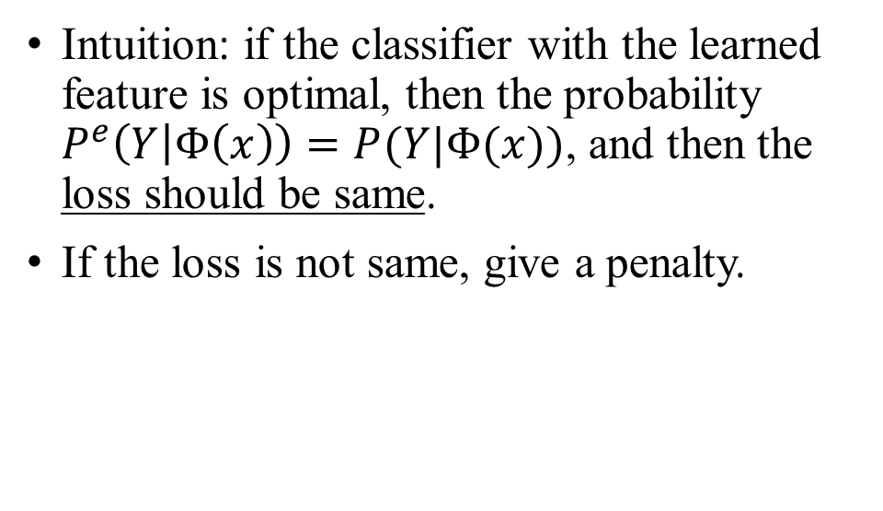
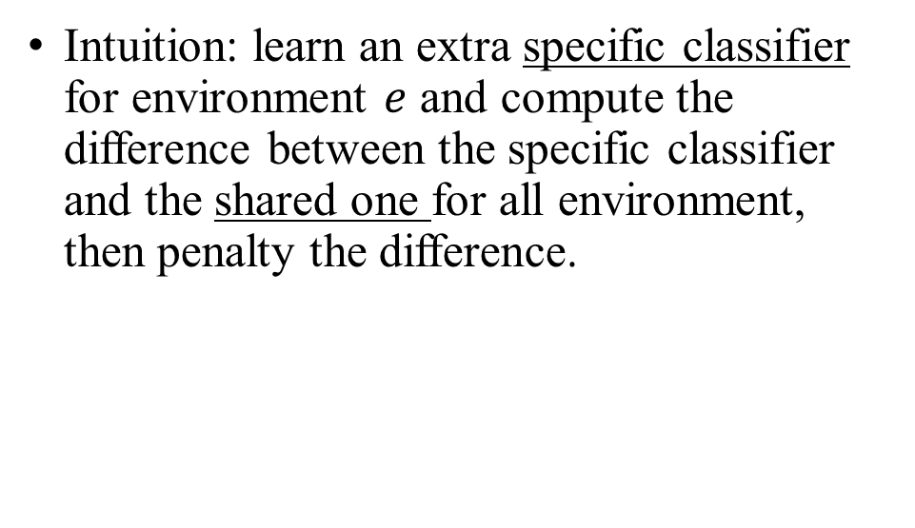
More versions of IRM
Intuition: if the classifier with the learned feature is optimal, then the probability $P^{e}\left(Y | Φ\left(x\right)\right)=P(Y|Φ(x))$, and then the loss should be same.
If the loss is not same, give a penalty.
Intuition: learn an extra specific classifier for environment $e$ and compute the difference between the specific classifier and the shared one for all environment, then penalty the difference.
Out-of-distribution generalization via risk extrapolation (rex). ICML 2021.
Invariant rationalization. ICML2020.

Slide 22
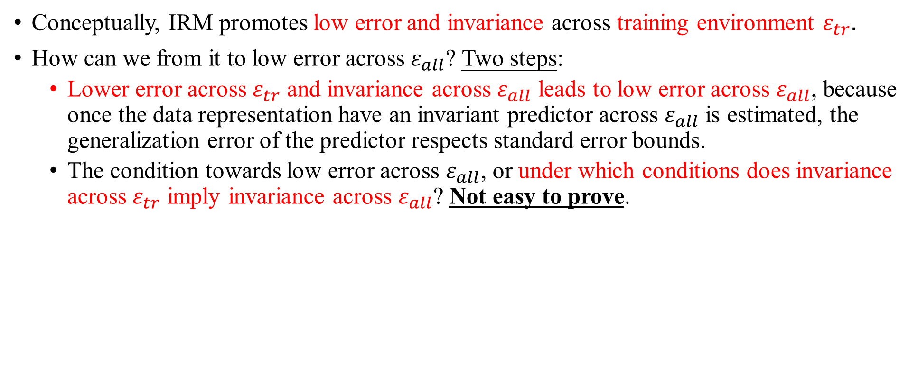
Is IRM useful for OOD generalization?
Conceptually, IRM promotes low error and invariance across training environment $ε_{tr}.$
How can we from it to low error across $ε_{all}$? Two steps:
Lower error across $ε_{tr}$ and invariance across $ε_{all}$ leads to low error across $ε_{all}$, because once the data representation have an invariant predictor across $ε_{all}$ is estimated, the generalization error of the predictor respects standard error bounds.
The condition towards low error across $ε_{all}$, or under which conditions does invariance across $ε_{tr}$ imply invariance across $ε_{all}$? Not easy to prove.

Slide 23
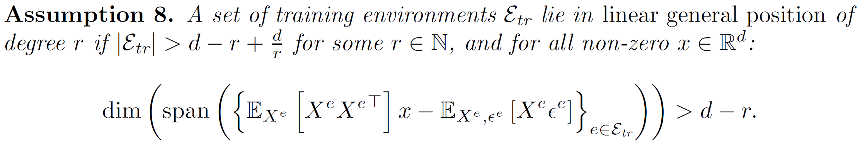
For linear IRM, it requires sets of training environments containing sufficient diversity and satisfying an underlying invariance.
The lower bound of number of environment is the dimension of spurious feature [1].
Under the assumption of linear general position, we can show that IRM learns across training environments transfer to all environments.
Non-linear general position is not proved.
[1] The Risks of Invariant Risk Minimization. ICLR 2020.

Slide 24
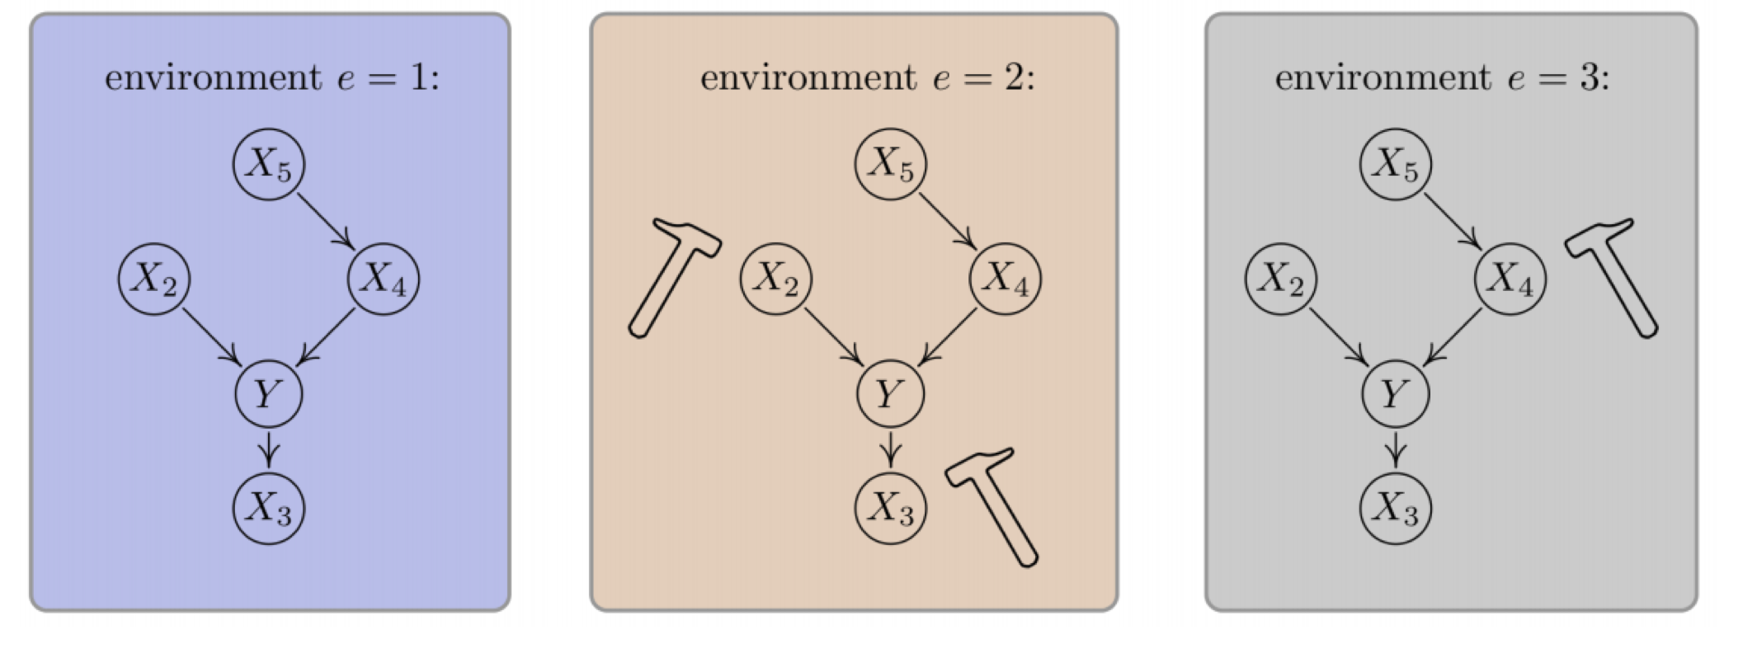
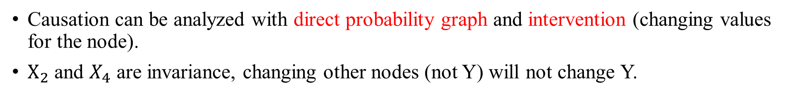
Understandings of invariance vs causation
Causation can be analyzed with direct probability graph and intervention (changing values for the node).
$X_{2}$ and $X_{4}$ are invariance, changing other nodes (not Y) will not change Y.
https://clarelyle.com/posts/2020-07-11-icml.html

Slide 25
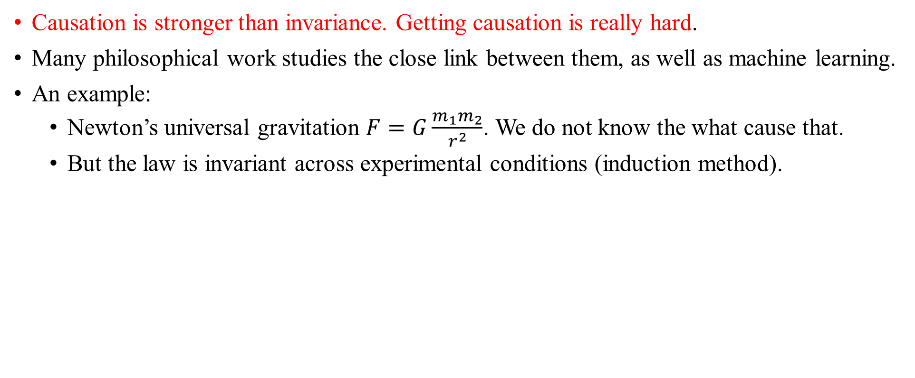
Causation is stronger than invariance. Getting causation is really hard.
Many philosophical work studies the close link between them, as well as machine learning.
An example:
Newton’s universal gravitation $F=G\frac{m_{1}m_{2}}{r^{2}}$. We do not know the what cause that.
But the law is invariant across experimental conditions (induction method).

Slide 26
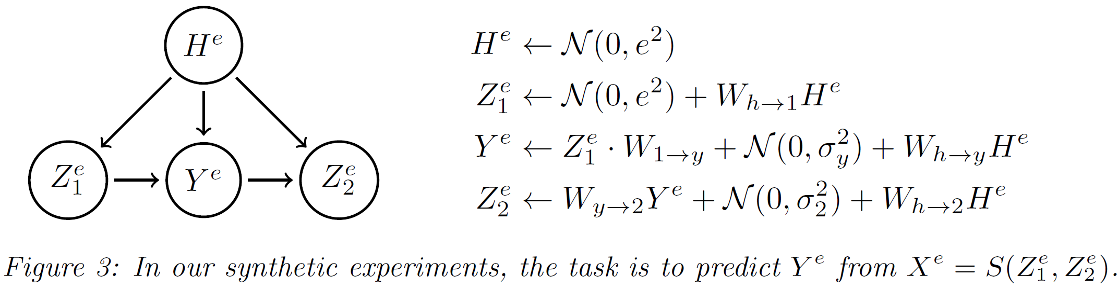
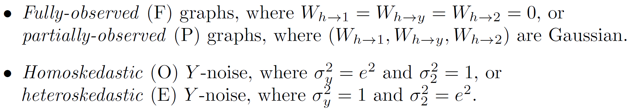
Experiments in synthetic data

Slide 27
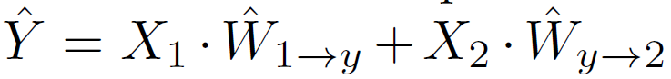
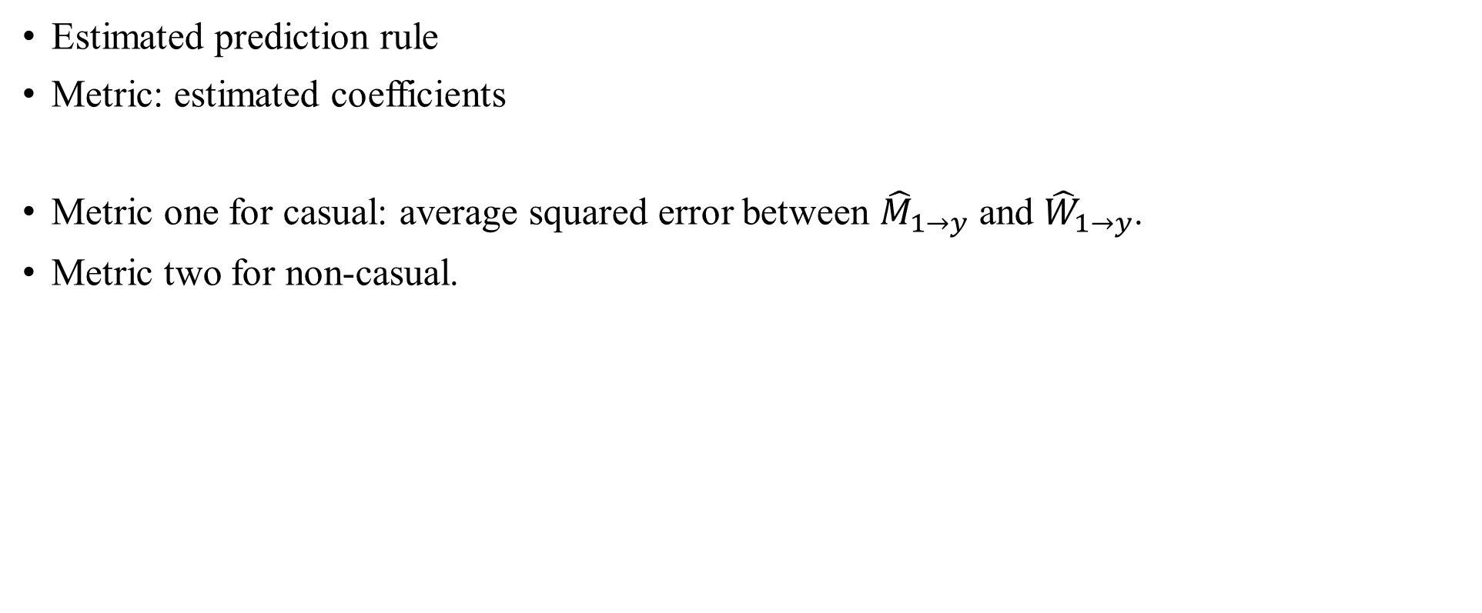
Estimated prediction rule
Metric: estimated coefficients
Metric one for casual: average squared error between ${\hat{M}}_{1→y}$ and ${\hat{W}}_{1→y}$.
Metric two for non-casual.

Slide 28
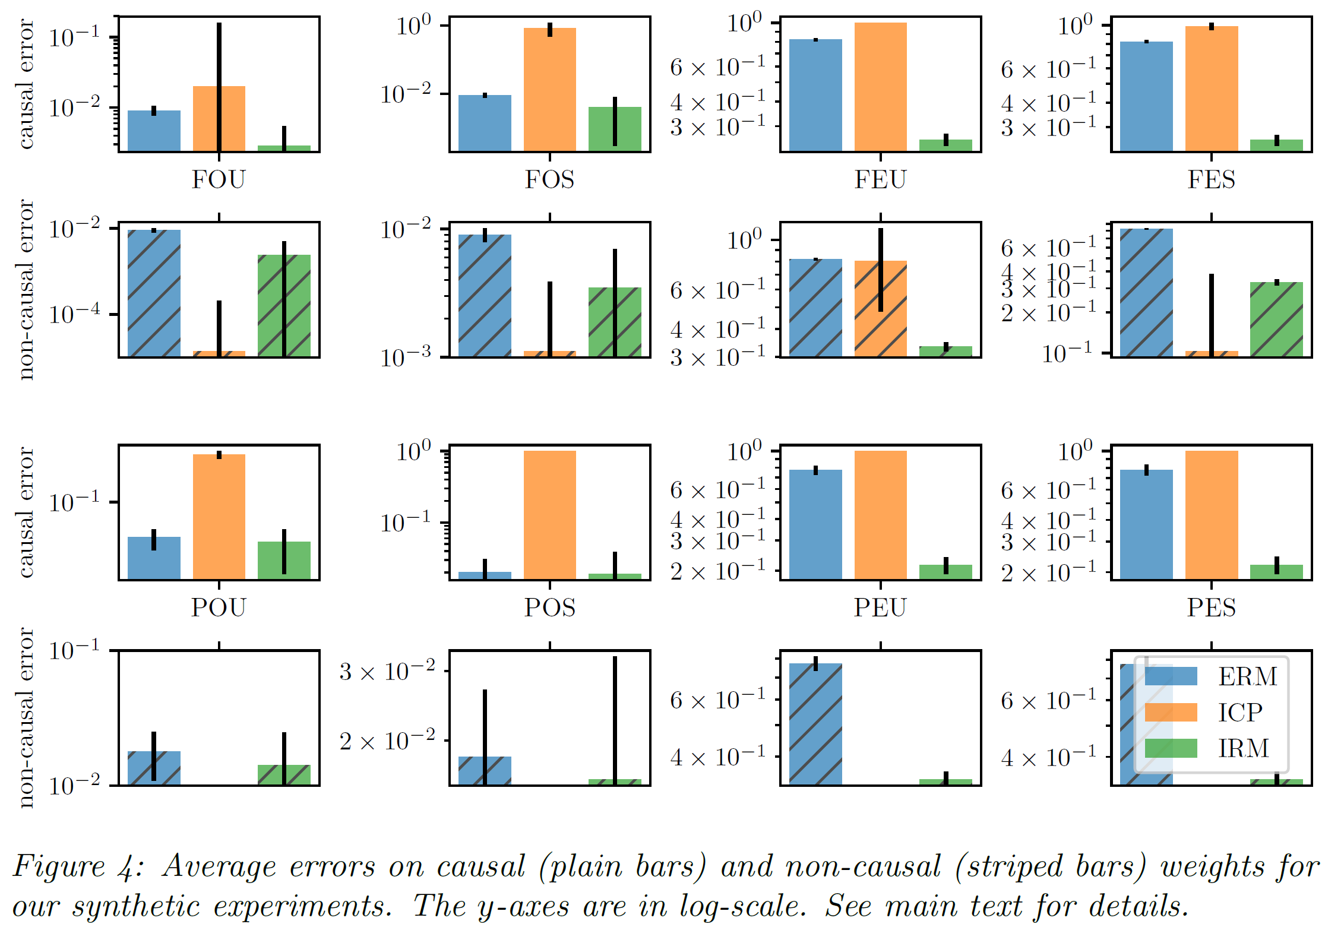

Slide 29
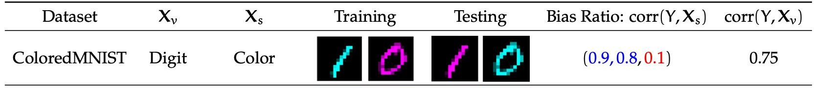
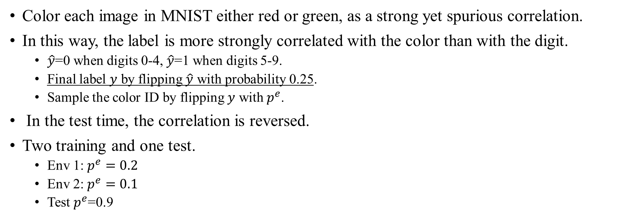
Experiments in colored MNIST
Color each image in MNIST either red or green, as a strong yet spurious correlation.
In this way, the label is more strongly correlated with the color than with the digit.
$\hat{y}$=0 when digits 0-4, $\hat{y}$=1 when digits 5-9.
Final label $y$ by flipping $\hat{y}$ with probability 0.25.
Sample the color ID by flipping $y$ with $p^{e}$.
In the test time, the correlation is reversed.
Two training and one test.
Env 1: $p^{e}=0.2$
Env 2: $p^{e}=0.1$
Test $p^{e}$=0.9

Slide 30
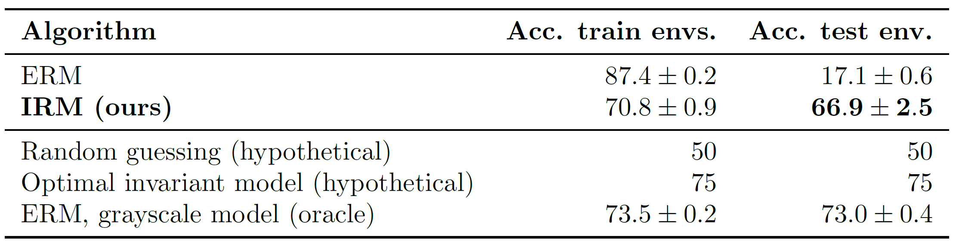
IRM worse in training but relies less on the color and hence better generalization.
Oracle, no color information when making the training and test datasets.

Slide 31
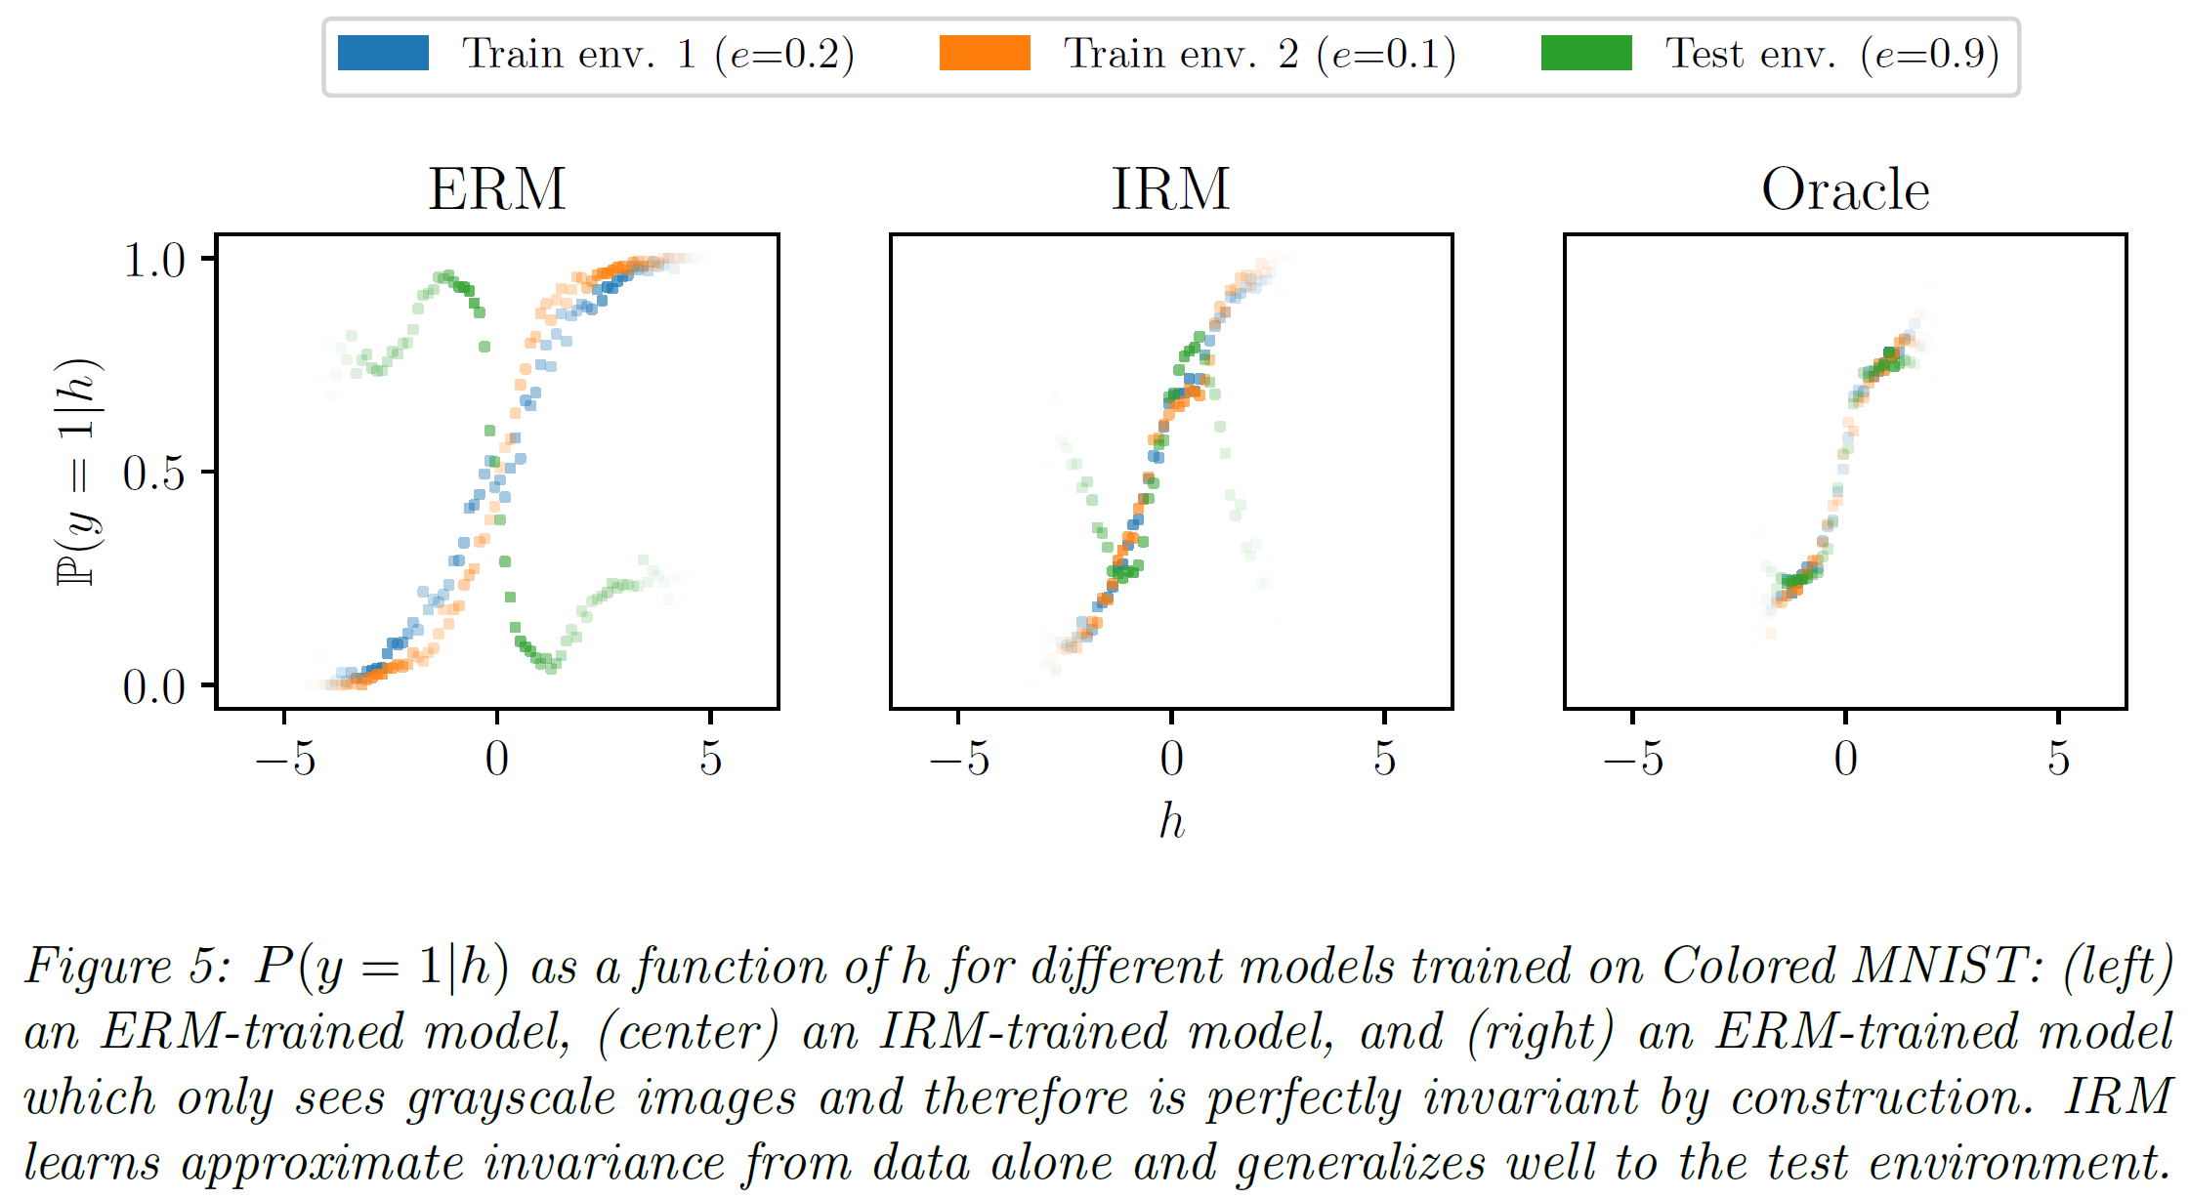
Difference between three environments
Tale, may because of finite sample issues.
Linear invariance (classifier) is not always hold.

Slide 32
Conclusion
IRM to mitigate OOD generalization.
Causality → invariance → feature + optimal linear classifier.
Extra challenges:
How should we do if the difference of marginal distribution is non-trivial?
Can we use it in generic datasets of image classification, such as ImageNet-1K?
Can we use the loss with deep learning models, such as ResNet50 and ViT-Base.

Slide 33
Thank You

